Slide 1
Impact of COVID-19 on Mental Health in United States
Group D1: Jie Feng, Jungkyu Kim, Riley Williamson, Rodney Davemann,Veera Supraja Koppisetty, Felix Ogbodu
Instructor: Thomas Raczkowski
TA: Sumit Malik
Date: 05/01/2021

Slide 2
Introduction
Background:
Covid-19 pandemic
Mental health issue
Questions:
Has COVID_19 affected the mental health of Americans?
Are areas high COVID-19 deaths more impacted by mental health issues?
Do areas with low COVID-19 rates have lower rates of mental health issues?
How has Georgia been impacted?
By Veera Supraja Koppisetty

Slide 3
Data importation
Datasets:
Indicators_of_Anxiety_or_Depression_Based_on_Reported_Frequency_of_Symptoms_During_Last_7_Days(also called Anxiety_data)
COVID_Cases_And_Deaths_Data_From_2020_to_2021(Also called us_states )
We have got our required covid data , anxiety deaths data from CDC since 2020
Number of rows in Covid Data set : 23059
Number of rows in Anxiety Data set : 5784
By Veera Supraja Koppisetty

Slide 4
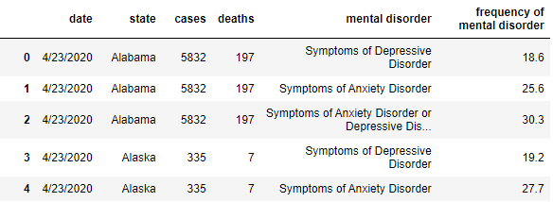
Data cleaning
Imported CSV files as DataFrames
Deleted unnecessary columns
Changed the date formats to match for merging
Changed the column names to assist the merging process and be more meaningful
Merged data
By Jungkyu Kim

Slide 5
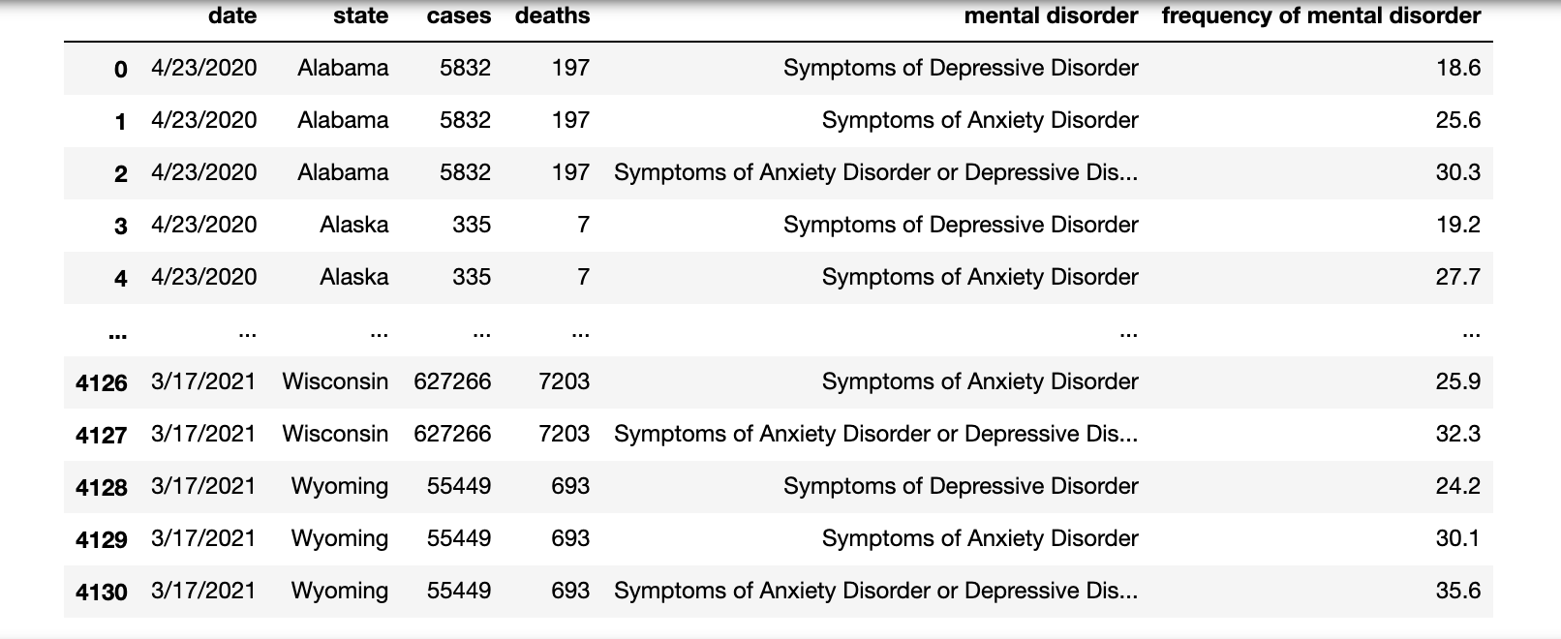
Data Merging
Merge conducted on the common column i.e., state
After the merge:
Number of rows in Merged Data set: 4131
Merged Data looks like
By
Veera Supraja Koppisetty

Slide 6
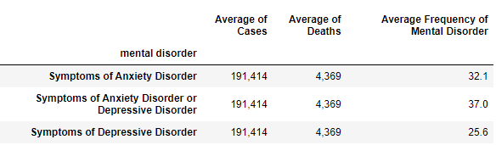
Data analysis: Frequency Table
By Rodney Davemann

Slide 7
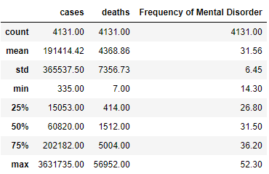
Data Analysis: Statistics
By Rodney Davemann

Slide 8
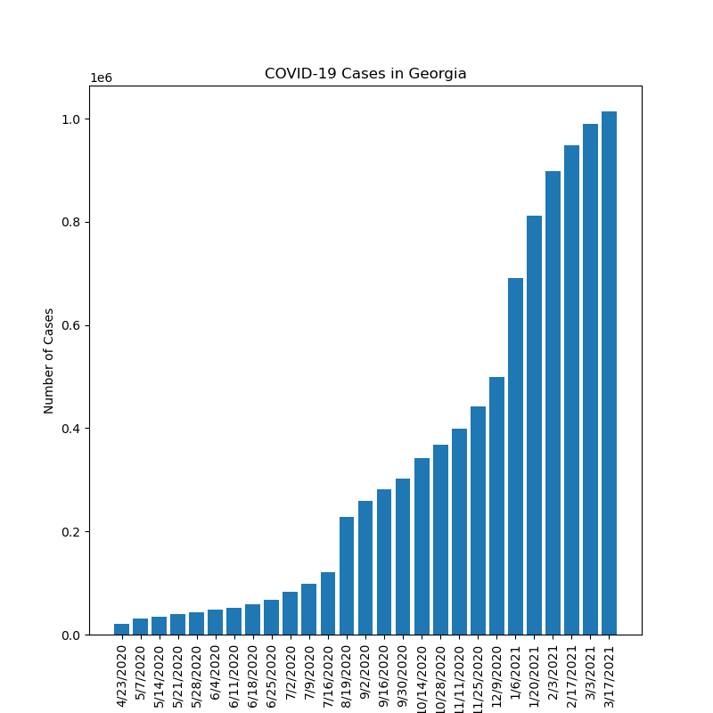
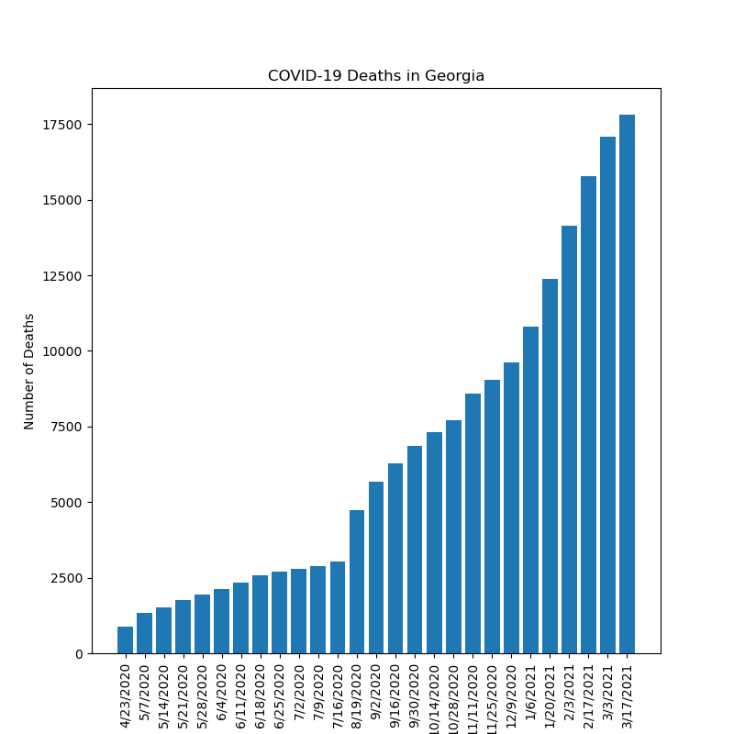
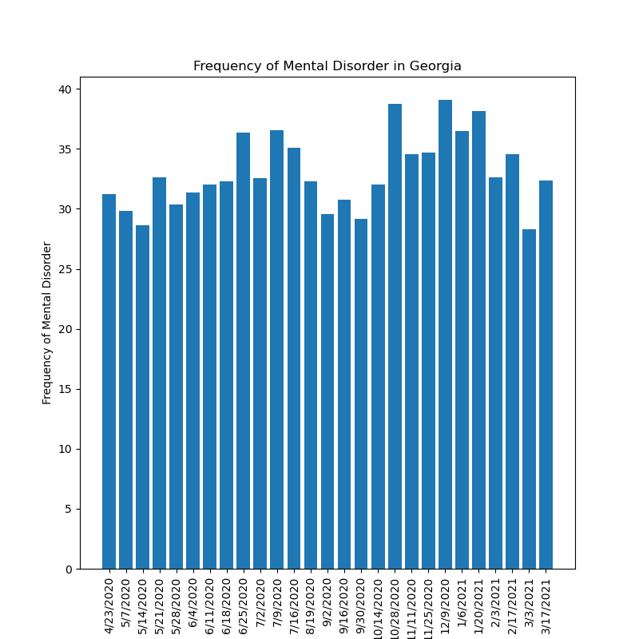
Data analysis Question: How has Georgia been impacted?
By Jie Feng

Slide 9
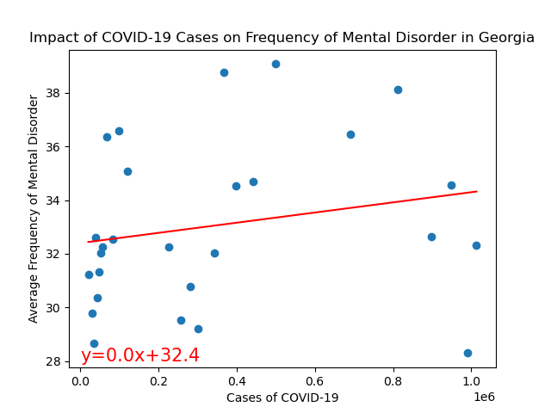
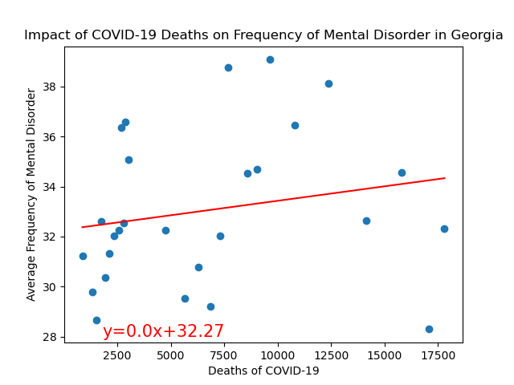
Data analysis Question: How has Georgia been impacted?
The r value is 0.04.
The r value is 0.04.
By Jie Feng

Slide 10
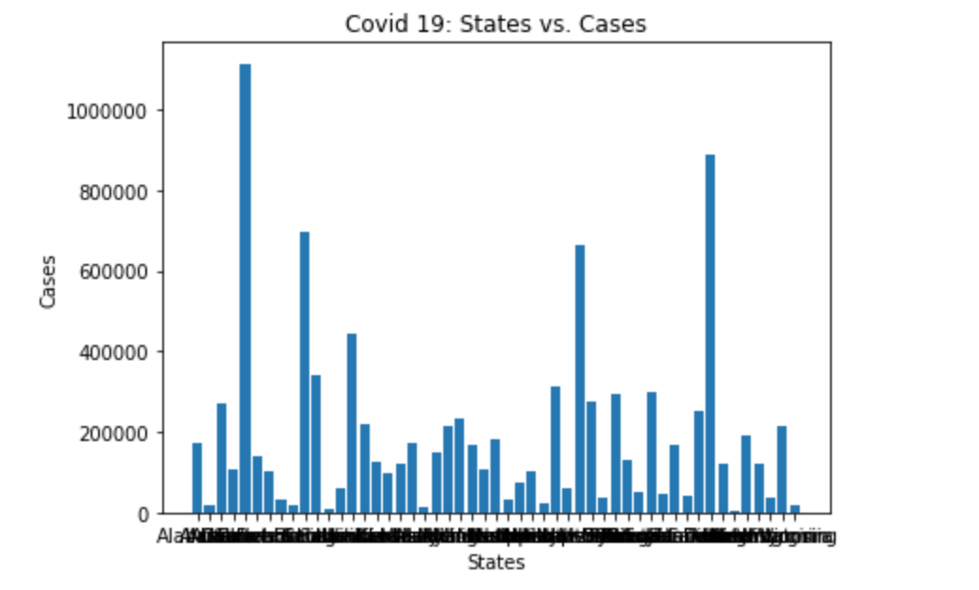
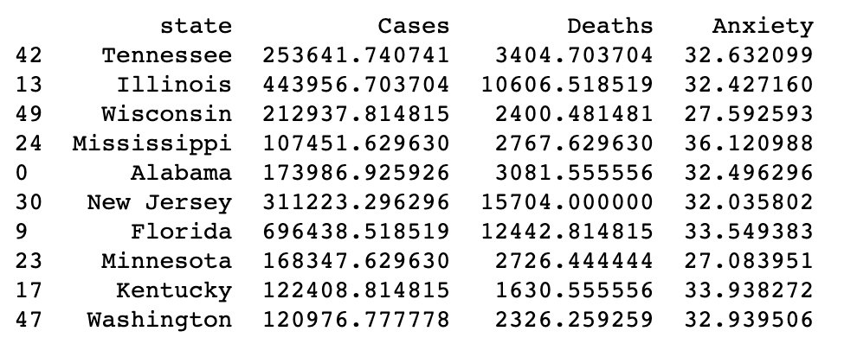
Means and analysis
By Felix Ogbodu

Slide 11
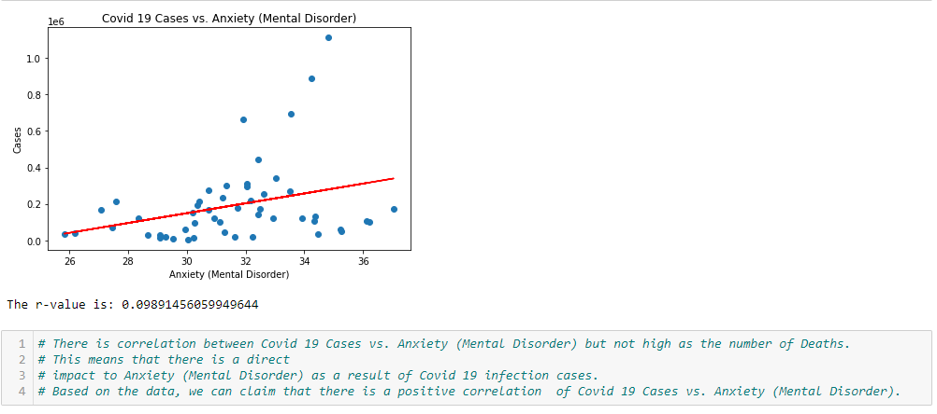
Covid cases vs Anxiety
By Felix Ogbodu

Slide 12
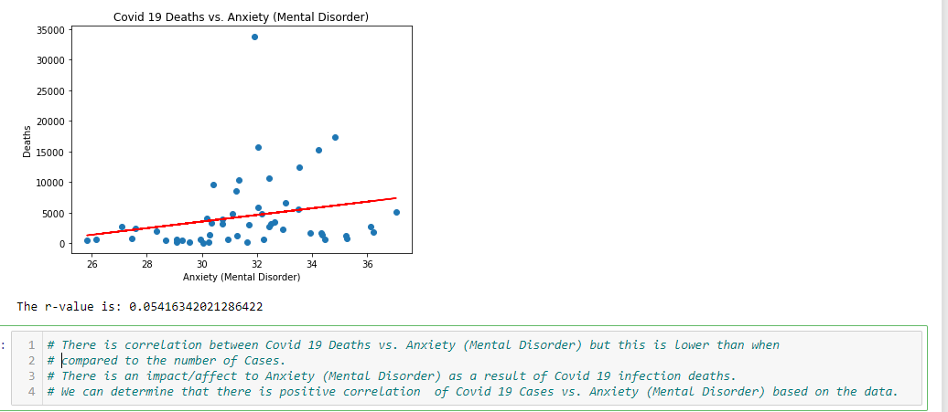
Covid deaths vs anxiety
By Felix Ogbodu

Slide 13
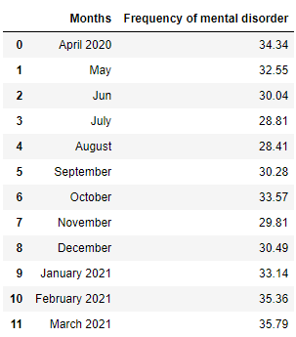
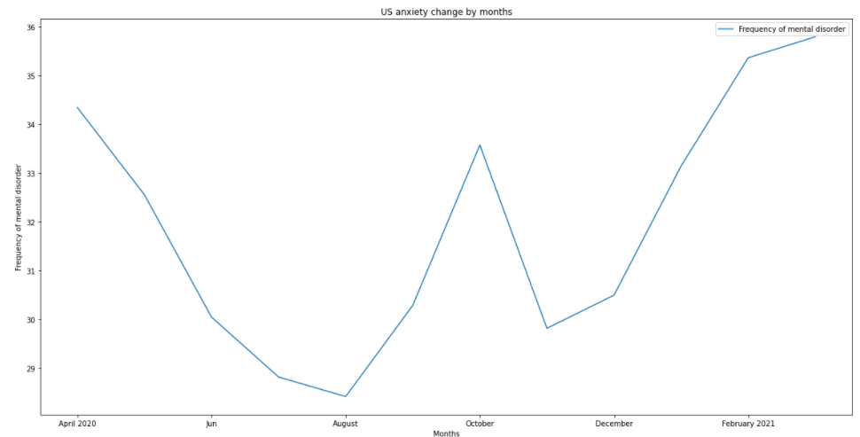
US Mental Disorders by Month
By Jungkyu Kim

Slide 14
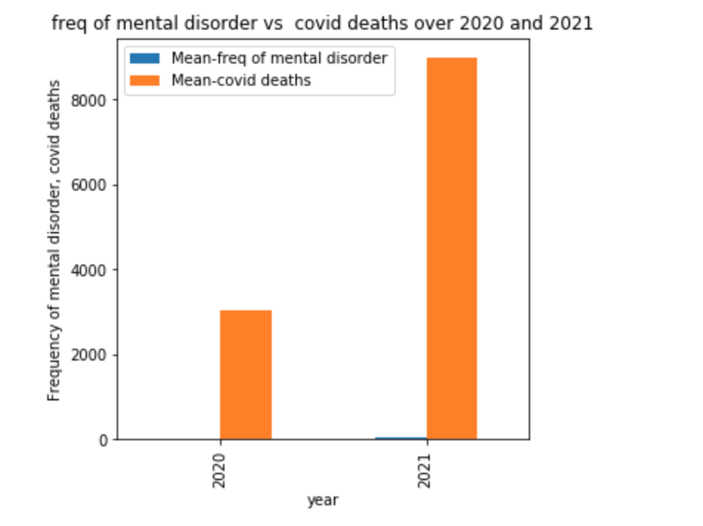
US Mental Disorders by Year
By Veera Supraja Koppisetty

Slide 15
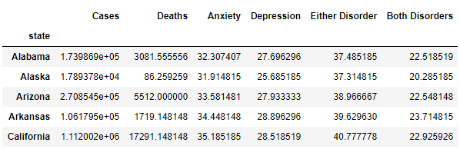
Data Analysis: Data by each disorder
By Riley Williamson

Slide 16
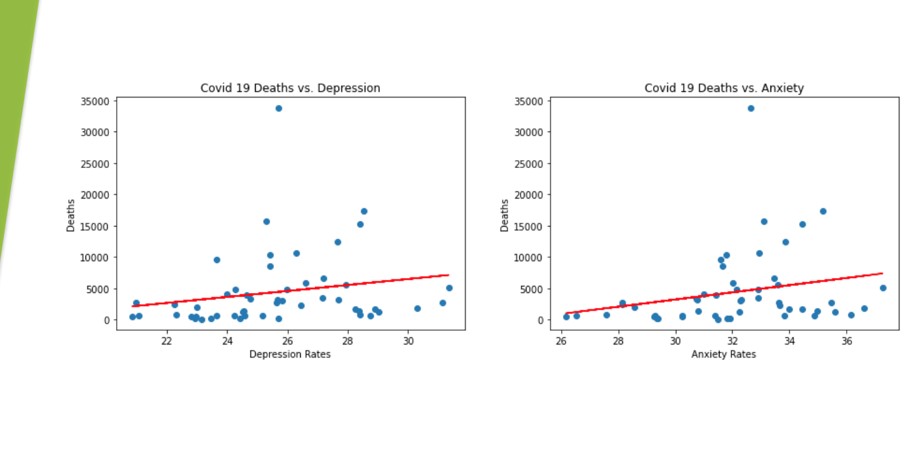
Covid-19 vs fatality slide back
By Riley Williamson

Slide 17
Summary statistics
The total number of cases is 9,762,136.
The total number of deaths is 222,812.
The average rate of anxiety is 32.08%.
The average rate of depression is 25.65%.
The average rate of anxiety or depression symptoms is 36.98%.
The average rate for both anxiety and depression symptoms is 20.72%.
By Riley Williamson

Slide 18
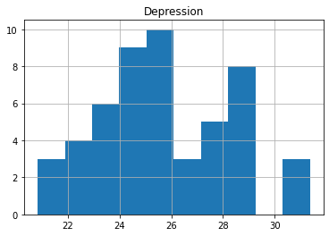
P-test
CDC 2019 Study: 18.5% of Americans have symptoms of depression
H0: 25.63<=18.5 | H1: 25.63>18.5
z-score: 2.795
Confidence level: 95%
p-value: 0.003
Because the p-value is less than the significance level, we have significant evidence to reject the null hypothesis. With this analysis, we can say with 95% confidence that depression rates for Americans have been higher during the pandemic.
By Riley Williamson

Slide 19
Conclusion
From this data, we can conclude that there is a positive correlation between COVID-19 and mental illness.
We have evidence that states with higher COVID rates also have higher rates of mental disorders.
We also have evidence that the average rate of depression symptoms has increased since the pandemic began.
We did not find a correlation between weekly rates of COVID-19 and weekly rates of mental disorders.
By Veera Supraja Koppisetty

